Slide 1
VGSALES ANALYSIS
Sales Analysis for Nintendo Sports games based on Year of Publish and Platform
By Okwaraojimadu Chisom K.

Slide 2
Data Card
This dataset contains a list of video games with sales greater than 100,000 copies. Fields include:
Rank - Ranking of overall sales
Name - The games name
Platform - Platform of the game’s release
Year - Year of game’s release
Genre - Genre of the game
Publisher - Publisher of the game
NA_Sales - Sales in North America (in millions)
EU_Sales - Sales in Europe (in millions)
JP_Sales - Sales in Japan (in millions)
Other_Sales - Sales in the rest of the world (in millions)
Global_sales - Total worldwide sales

Slide 3
Aims and Objectives
Aim of the objectives
Sales analysis for Nintendo sports games based on Year and Platform
Objectives
Best Selling Nintendo sports games in the world for Wii
Best selling years for Nintendo sports games in the world for Wii
Best Selling Nintendo sports games in North America for Wii
Best selling years for Nintendo sports games in North America for Wii
Best Selling Nintendo sports games in the world for Gameboy(GB)
Best selling years for Nintendo sports games in the world for Dual Screen(DS)
Best Selling Nintendo sports games in North America for DS
Best selling years for Nintendo sports games in North America for DS

Slide 4
Methodology
Data Reconnaissance
Data Upload
Data Cleaning: Remove empty cells, Remove duplicates, Remove improper values (Max and Min)
Cleaned Data Exportation
Analysis on Excel
Data Processing
Data Visualization

Slide 5
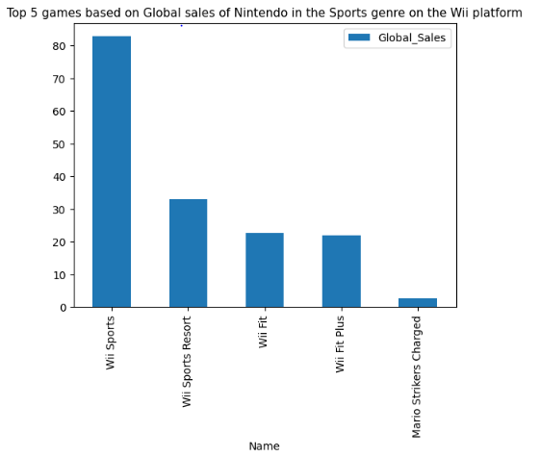
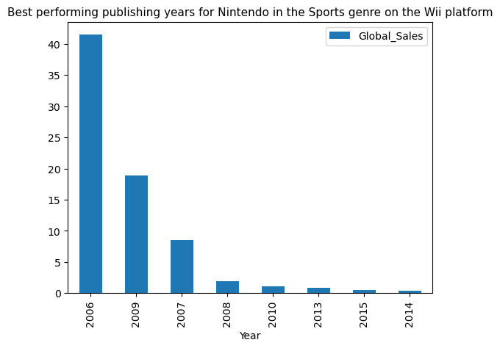
Wii Global Sales

Slide 6
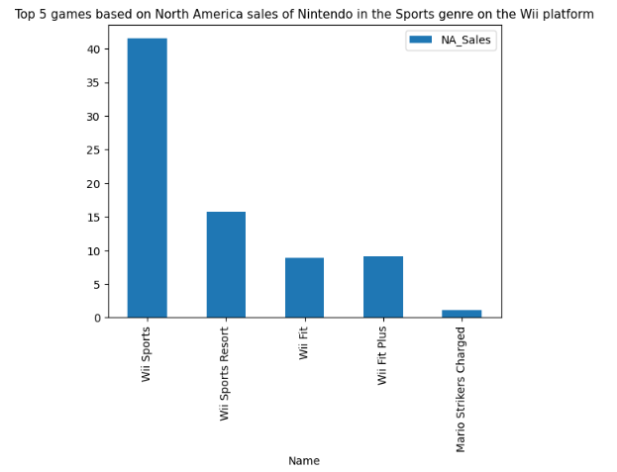
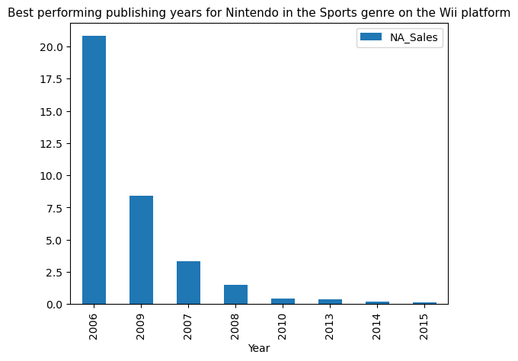
Wii North America Sales

Slide 7
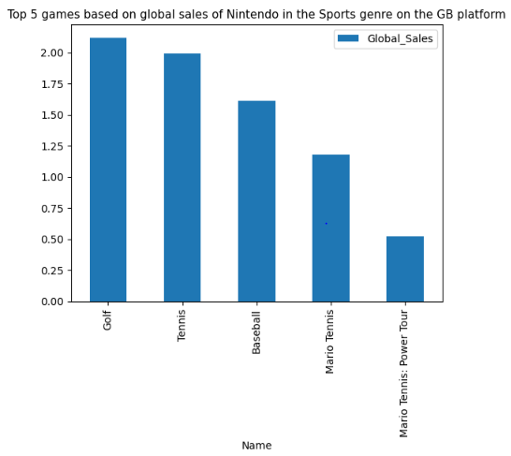
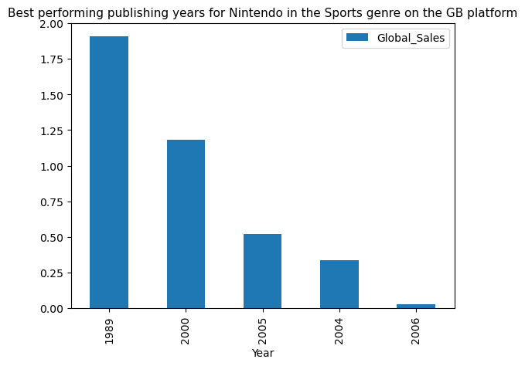
Gameboy (GB) Global Sales

Slide 8
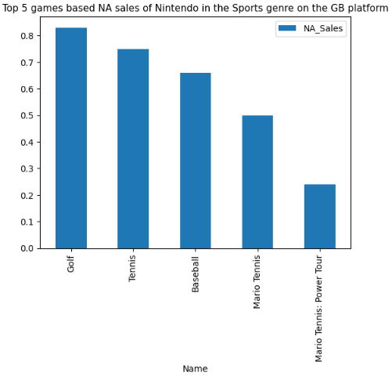
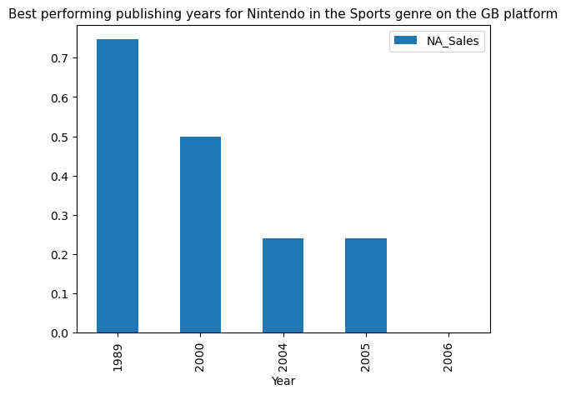
Gameboy (GB) North America Sales

Slide 9
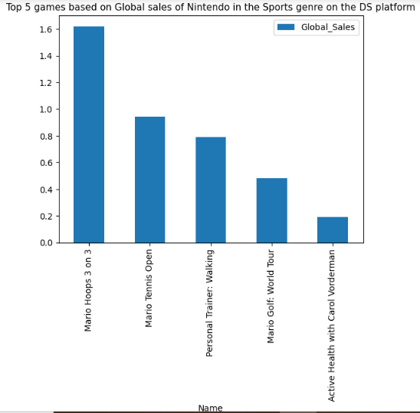
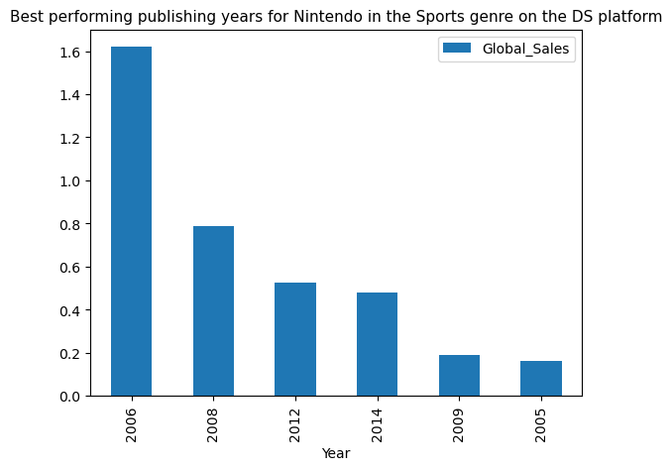
Dual Screen (DS) Global Sales

Slide 10
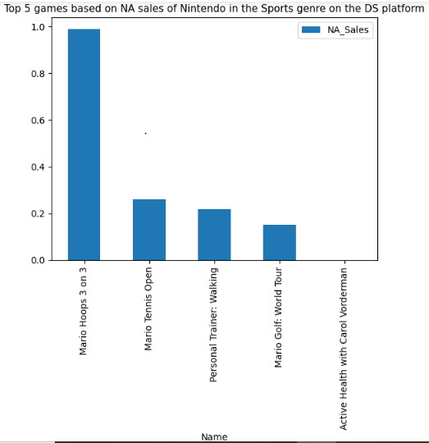
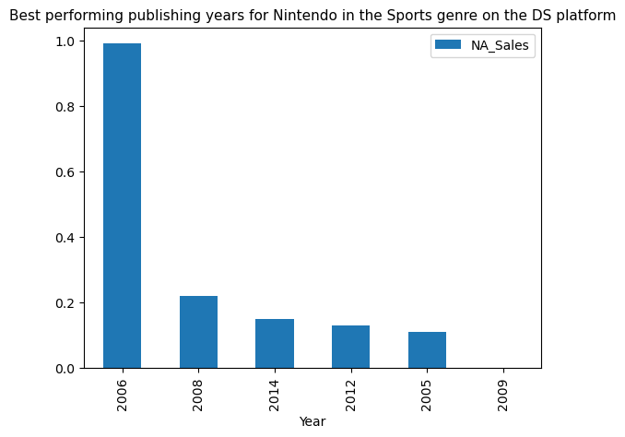
Dual Screen (DS) North America Sales

Slide 11
Conclusion

